Slide 1
Hospital Database Analysis
A Comprehensive MySQL-Based Analysis of Hospital Performance, Cost, and Patient Outcomes .
By Sakshi Kumbhar

Slide 2
INTRODUCTION
In this project, I worked on analyzing hospital data using SQL to understand revenue performance, doctor productivity, patient behavior, and operational efficiency.
Hospitals generate a large amount of data daily — appointments, treatments, billing, and payments — but without proper analysis, it’s difficult to make informed business decisions.
The goal of this project was to convert raw hospital data into meaningful insights that could support better financial and operational decisions.

Slide 3
Problem
Objectives
The hospital management needed clarity on:
Revenue concentration across treatments and doctors
Outstanding payments impacting cash flow
Operational inefficiencies due to cancellations
Uneven doctor workload distribution
Evaluate hospital revenue and billing performance
Measure doctor workload and department efficiency
Analyze treatment cost and profitability
Assess patient outcomes and repeat visits
Support data-driven decision-making for hospital management

Slide 4
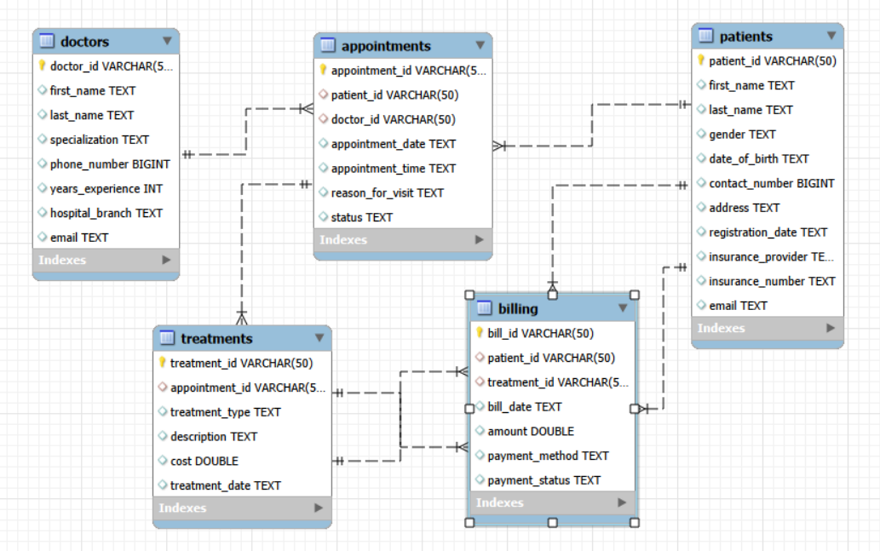

Slide 5
DATA CLEANING & TABLE CONNECTIONS
Data Updates Performed
Before analysis, I standardized and prepared the database:
Converted all ID columns to VARCHAR(50) for consistency.
Defined Primary Keys to uniquely identify each record.
Ensured no duplicate key values.
Verified data types for dates and amounts.
Table Relationships (Data Modeling)
To connect tables properly, I implemented Foreign Key constraints.
Relationship Flow:
Patients → Appointments
Doctors → Appointments
Appointments → Treatments
Treatments → Billing

Slide 6
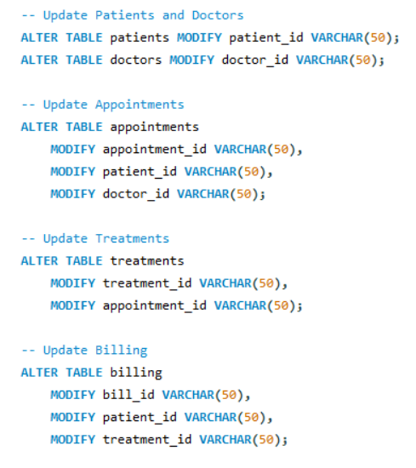
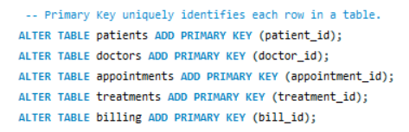
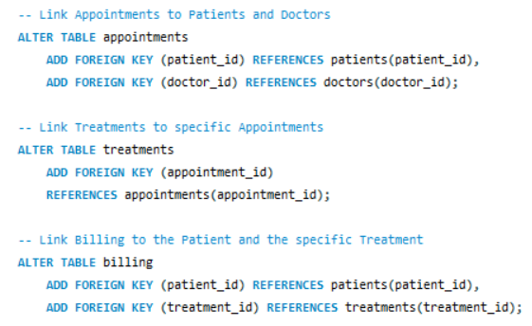

Slide 7
KEY BUSINESS QUESTIONS ADDRESSED
What is the total revenue generated by the hospital?
How does revenue vary month-by-month?
Which treatments generate the highest revenue?
Which doctors contribute the most to total revenue?
How does revenue distribution vary across doctor specializations?
What is the distribution of payment statuses (Paid, Pending, Failed)?
How much revenue is currently outstanding or unpaid?
Which payment methods are most frequently used by patients?
How many appointments does each doctor handle?
How do doctors rank in terms of revenue generation?
Are there any doctors with zero appointments (underutilization)?
Which patients visit frequently (retention indicator)?
How much revenue is contributed by each insurance provider?
How many appointments are being cancelled?
What is the estimated revenue loss due to cancellations and no-shows?

Slide 8
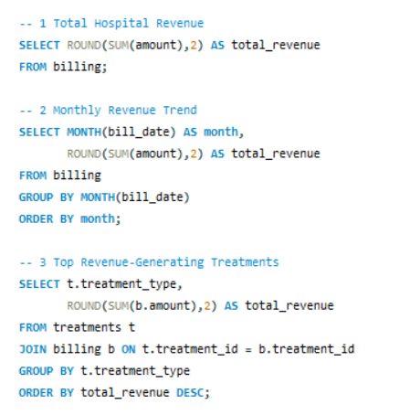
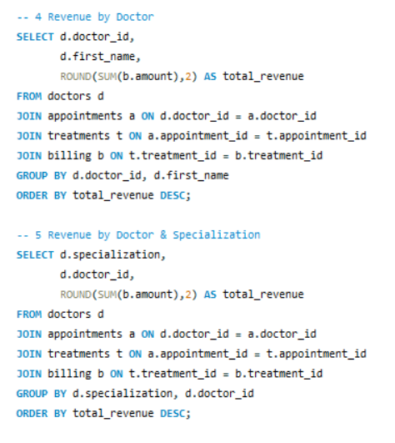

Slide 9
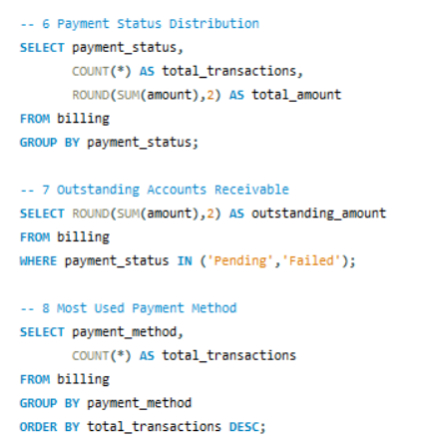
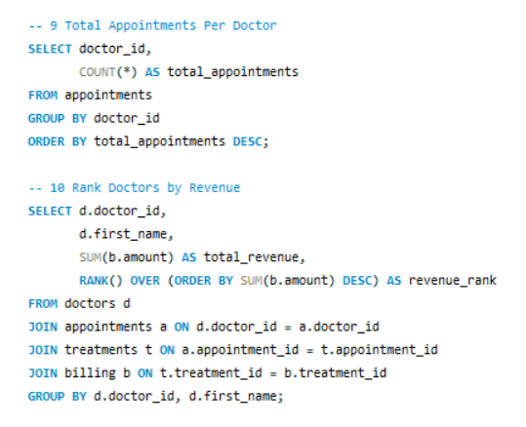

Slide 10
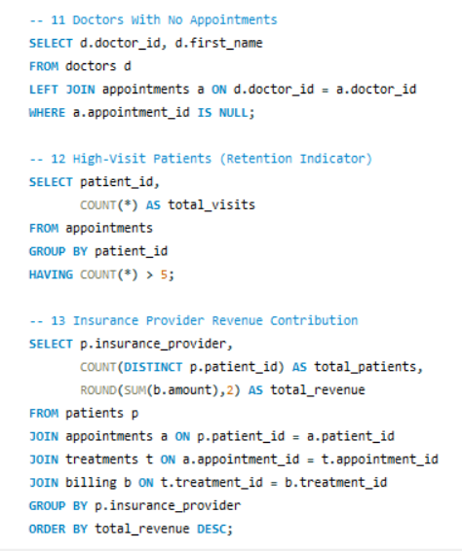
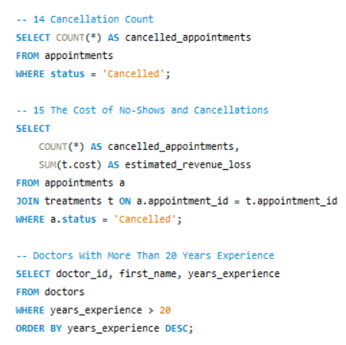

Slide 11
KEY INSIGHTS
Revenue is driven by a small group of treatments and doctors.
Doctor productivity and workload are unevenly distributed.
Outstanding payments are impacting cash flow.
Cancellations are causing direct revenue loss.
Revenue dependency exists on select insurance providers.

Slide 12
BUSINESS CONCLUSIONS
Focus on scaling high-revenue treatments.
Optimize doctor capacity and performance management.
Strengthen payment recovery processes.
Implement strategies to reduce cancellations.
Diversify revenue sources to reduce financial risk.

Slide 13
THANK YOU

